Slide 1
ES6 - Features
Sai Vardhan T

Slide 2
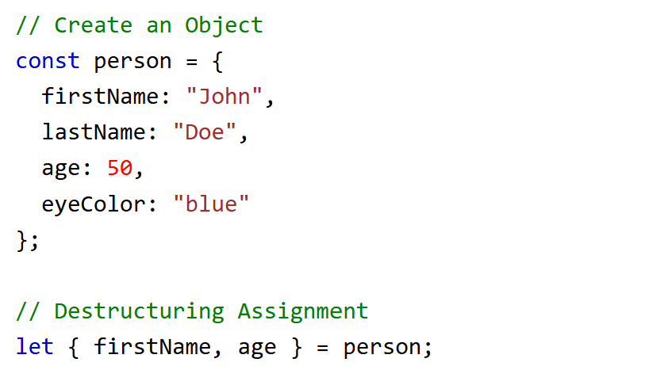
Object Destructuring
Destructuring assignment makes it easy to assign array values and object properties to variables.

Slide 3
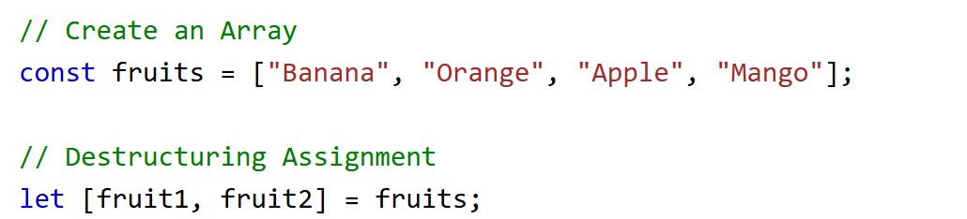
Array Destructuring
Destructuring assignment makes it easy to assign array values and object properties to variables.

Slide 4
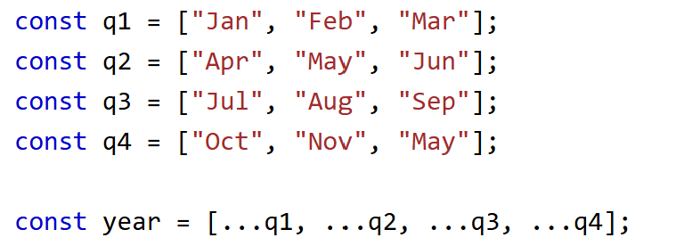
The Spread (...) Operator
The ... operator expands an iterable (like an array) into more elements:

Slide 5
PROMISES
A Promise represents a value that may be available now, in the future, or never. It has three states:
Pending – Initial state, neither fulfilled nor rejected.
Fulfilled – The operation completed successfully.
Rejected – The operation failed.

Slide 6
PROMISES
Classification of Promises:
Creation of Promise
Handling Promises
Using then and catch
Using async and await
Chaining Promises
Promise Methods

Slide 7
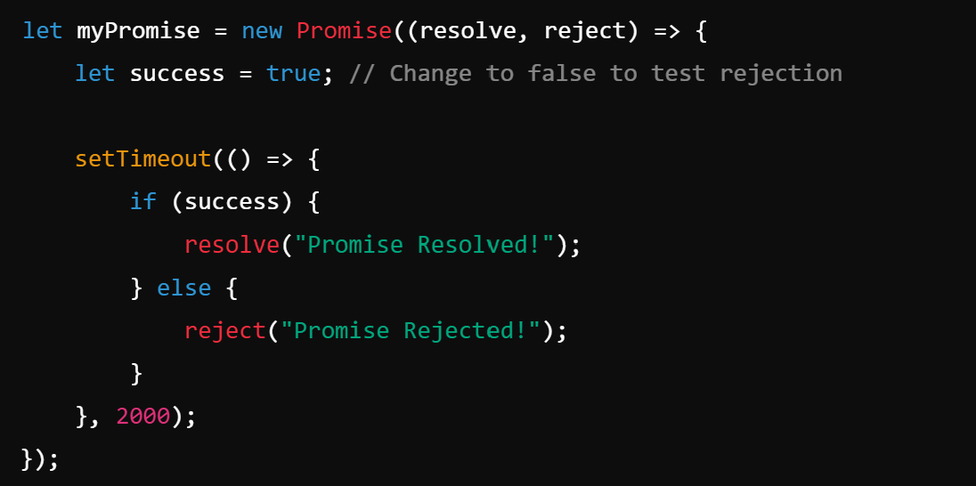
CREATION OF PROMISE
A Promise is created using the Promise constructor:

Slide 8
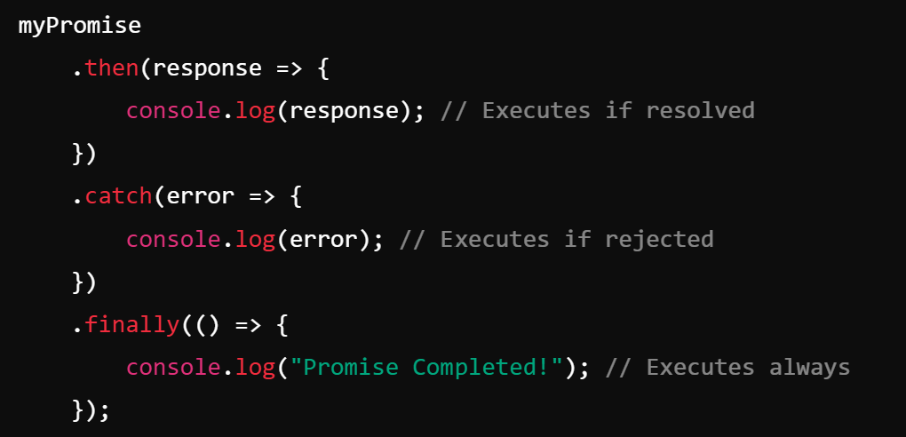
Handling Promises
Using .then() and .catch()

Slide 9
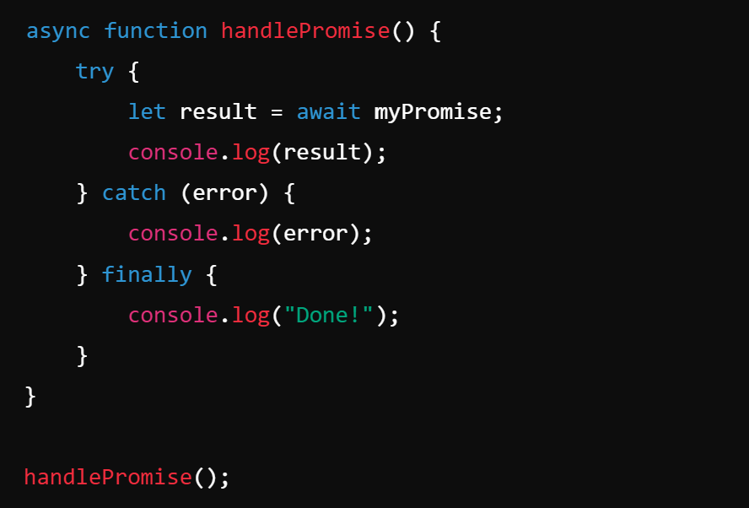
Handling Promises
Using async/await (Modern Approach)

Slide 10
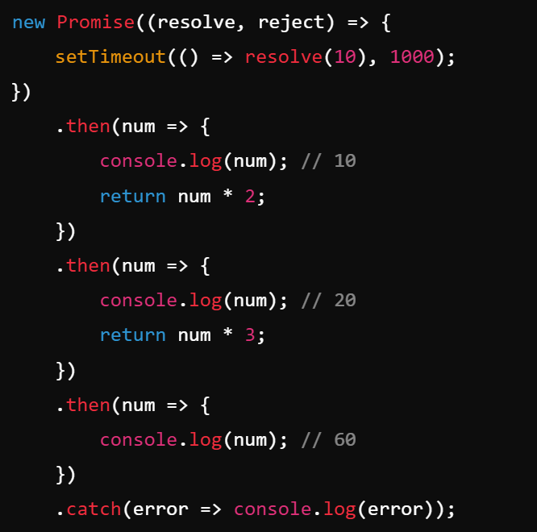
CHAINING PROMISES

Slide 11
PROMISE METHODS
Promise.all()
Promise.race()
Promise.allSettled()
Promise.any()

Slide 12
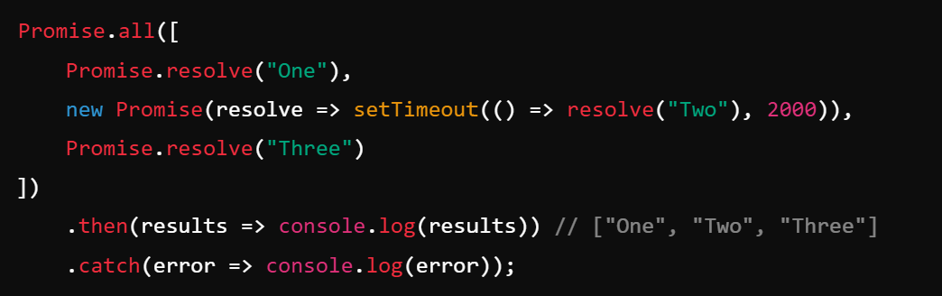
Promise.all()
Runs all promises in parallel and waits for all to resolve.

Slide 13
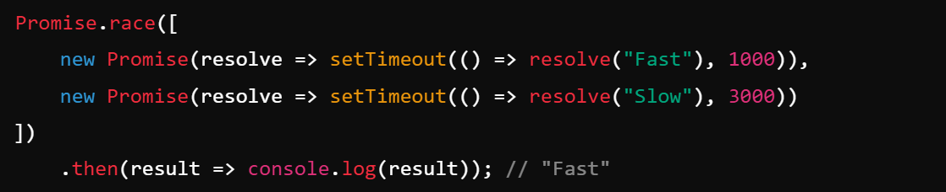
Promise.race()
Returns the first settled promise.

Slide 14
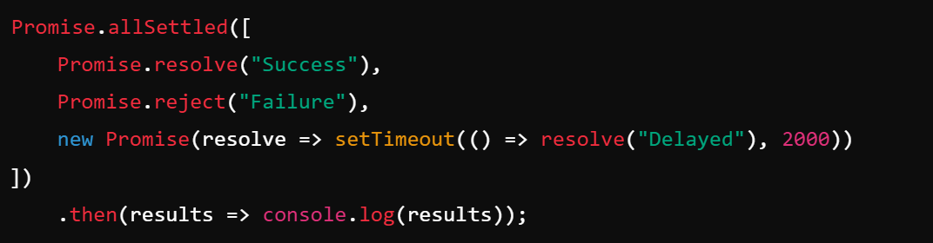
Promise.allSettled()
Waits for all promises and returns their status.

Slide 15
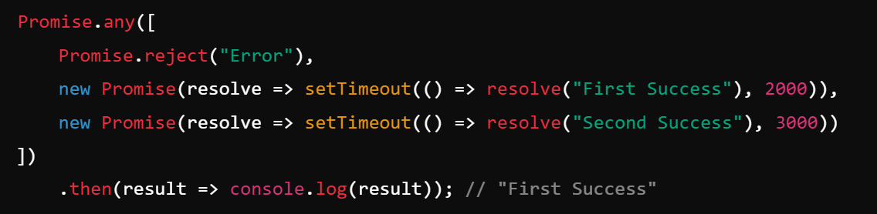
Promise.any()
Returns the first resolved promise (ignores rejections).

